Slide 1
UNIT 1
INTRODUCTION TO PYTHON

Slide 2
Python is a general-purpose interpreted, interactive, object-oriented, and high-level programming language. It was created by Guido van Rossum during 1985- 1990. Like Perl, Python source code is also available under the GNU General Public License (GPL).

Slide 3
Python is a high-level, interpreted, interactive and object-oriented scripting language. Python is designed to be highly readable. It uses English keywords frequently where as other languages use punctuation, and it has fewer syntactical constructions than other languages.

Slide 4
Advantages of Python:
Python is Interpreted − Python is processed at runtime by the interpreter. You do not need to compile your program before executing it. This is similar to PERL and PHP.
Python is Interactive − You can actually sit at a Python prompt and interact with the interpreter directly to write your programs.

Slide 5
Python is Object-Oriented − Python supports Object-Oriented style or technique of programming that encapsulates code within objects.
Python is a Beginner's Language − Python is a great language for the beginner-level programmers and supports the development of a wide range of applications from simple text processing to WWW browsers to games.

Slide 6
Characteristics
It supports functional and structured programming methods as well as OOP.
It can be used as a scripting language or can be compiled to byte-code for building large applications.

Slide 7
It provides very high-level dynamic data types and supports dynamic type checking.
It supports automatic garbage collection.
It can be easily integrated with C, C++, COM, ActiveX, CORBA, and Java.

Slide 8
Applications of Python
Easy-to-learn − Python has few keywords, simple structure, and a clearly defined syntax. This allows the student to pick up the language quickly.
Easy-to-read − Python code is more clearly defined and visible to the eyes.
Easy-to-maintain − Python's source code is fairly easy-to-maintain.

Slide 9
A broad standard library − Python's bulk of the library is very portable and cross-platform compatible on UNIX, Windows, and Macintosh.
Interactive Mode − Python has support for an interactive mode which allows interactive testing and debugging of snippets of code.

Slide 10
Portable − Python can run on a wide variety of hardware platforms and has the same interface on all platforms.
Extendable − You can add low-level modules to the Python interpreter. These modules enable programmers to add to or customize their tools to be more efficient.

Slide 11
Databases − Python provides interfaces to all major commercial databases.
GUI Programming − Python supports GUI applications that can be created and ported to many system calls, libraries and windows systems, such as Windows MFC, Macintosh, and the X Window system of Unix.
Scalable − Python provides a better structure and support for large programs than shell scripting.

Slide 12
History of Python
Python was developed by Guido van Rossum in the late eighties and early nineties at the National Research Institute for Mathematics and Computer Science in the Netherlands.
Python is derived from many other languages, including ABC, Modula-3, C, C++, Algol-68, SmallTalk, and Unix shell and other scripting languages.

Slide 13
Python is copyrighted. Like Perl, Python source code is now available under the GNU General Public License (GPL).
Python is now maintained by a core development team at the institute, although Guido van Rossum still holds a vital role in directing its progress.

Slide 14
Python Features
Python's features include −
Easy-to-learn − Python has few keywords, simple structure, and a clearly defined syntax. This allows the student to pick up the language quickly.
Easy-to-read − Python code is more clearly defined and visible to the eyes.

Slide 15
Easy-to-maintain − Python's source code is fairly easy-to-maintain.
A broad standard library − Python's bulk of the library is very portable and cross-platform compatible on UNIX, Windows, and Macintosh.
Interactive Mode − Python has support for an interactive mode which allows interactive testing and debugging of snippets of code.

Slide 16
Portable − Python can run on a wide variety of hardware platforms and has the same interface on all platforms.
Extendable − You can add low-level modules to the Python interpreter. These modules enable programmers to add to or customize their tools to be more efficient.
Databases − Python provides interfaces to all major commercial databases.

Slide 17
GUI Programming − Python supports GUI applications that can be created and ported to many system calls, libraries and windows systems, such as Windows MFC, Macintosh, and the X Window system of Unix.
Scalable − Python provides a better structure and support for large programs than shell scripting.

Slide 18
Where is Python used?
Python is a general-purpose, popular programming language and it is used in almost every technical field. The various areas of Python use are given below.
Data Science
Date Mining
Desktop Applications
Console-based Applications
Mobile Applications

Slide 19
Software Development
Artificial Intelligence
Web Applications
Enterprise Applications
3D CAD Applications
Machine Learning
Computer Vision or Image Processing Applications.
Speech Recognitions

Slide 20
Python Basic Syntax:
There is no use of curly braces or semicolon in Python programming language. It is English-like language. But Python uses the indentation to define a block of code. Indentation is nothing but adding whitespace before the statement when it is needed. For example -

Slide 21
def func():
statement 1
statement 2
…………………
…………………
statement N

Slide 22
Indentation in Python
Leading space or tab at the beginning of the line is considered as indentation level of the line, which is used to determine the group of statements. Statements with the same level of indentation considered as a group or block.
For example, functions, classes, or loops in Python contains a block of statements to be executed. Other programming languages such as C# or Java use curly braces { } to denote a block of code. Python uses indentation (a space or a tab) to denote a block of statements.

Slide 23
Indentation Rules
Use the colon : to start a block and press Enter.
All the lines in a block must use the same indentation, either space or a tab.
Python recommends four spaces as indentation to make the code more readable. Do not mix space and tab in the same block.
A block can have inner blocks with next level indentation.

Slide 24
Variables
Variable is a name that is used to refer to memory location. Python variable is also known as an identifier and used to hold value.
In Python, we don't need to specify the type of variable because Python is a infer language and smart enough to get variable type.

Slide 25
Variable names can be a group of both the letters and digits, but they have to begin with a letter or an underscore.
It is recommended to use lowercase letters for the variable name. Rahul and rahul both are two different variables.

Slide 26
Identifier Naming
Variables are the example of identifiers. An Identifier is used to identify the literals used in the program. The rules to name an identifier are given below.
The first character of the variable must be an alphabet or underscore ( _ ).

Slide 27
All the characters except the first character may be an alphabet of lower-case(a-z), upper-case (A-Z), underscore, or digit (0-9).
Identifier name must not contain any white-space, or special character (!, @, #, %, ^, &, *).
Identifier name must not be similar to any keyword defined in the language.
Identifier names are case sensitive; for example, my name, and MyName is not the same.

Slide 28
Examples of valid identifiers: a123, _n, n_9, etc.
Examples of invalid identifiers: 1a, n%4, n 9, etc.

Slide 29
Data Types
Variables can hold values, and every value has a data-type. Python is a dynamically typed language; hence we do not need to define the type of the variable while declaring it. The interpreter implicitly binds the value with its type.
a = 5
The variable a holds integer value five and we did not define its type. Python interpreter will automatically interpret variables a as an integer type.

Slide 30
Python enables us to check the type of the variable used in the program. Python provides us the type() function, which returns the type of the variable passed.

Slide 31
Consider the following example to define the values of different data types and checking its type.
a=10
b="Hi Python"
c = 10.5
print(type(a))
print(type(b))
print(type(c)) Output:<type 'int'>
<type 'str'>
<type 'float'>

Slide 32
A variable can hold different types of values. For example, a person's name must be stored as a string whereas its id must be stored as an integer.
Python provides various standard data types that define the storage method on each of them. The data types defined in Python are given below.
Numbers
Sequence Type
Boolean
Set
Dictionary

Slide 33
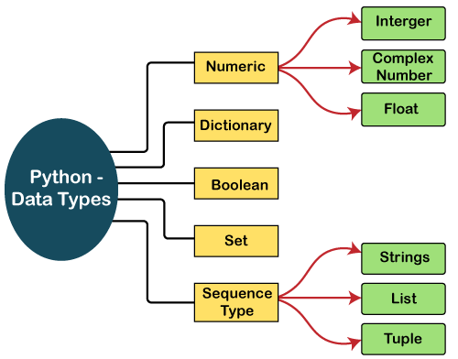

Slide 34
Numbers
Number stores numeric values. The integer, float, and complex values belong to a Python Numbers data-type. Python provides the type() function to know the data-type of the variable. Similarly, the isinstance() function is used to check an object belongs to a particular class.

Slide 35
Python creates Number objects when a number is assigned to a variable. For example;
a = 5
print("The type of a", type(a))
b = 40.5
print("The type of b", type(b))
c = 1+3j
print("The type of c", type(c))
print(" c is a complex number", isinstance(1+3j,complex))

Slide 36
Output:
The type of a <class 'int'>
The type of b <class 'float'>
The type of c <class 'complex'>
c is complex number: True

Slide 37
Python Casting
There may be times when you want to specify a type on to a variable. This can be done with casting. Python is an object-orientated language, and as such it uses classes to define data types, including its primitive types.

Slide 38
Casting in python is therefore done using constructor functions:
int() - constructs an integer number from an integer literal, a float literal (by rounding down to the previous whole number), or a string literal (providing the string represents a whole number)
float() - constructs a float number from an integer literal, a float literal or a string literal (providing the string represents a float or an integer)
str() - constructs a string from a wide variety of data types, including strings, integer literals and float literals

Slide 39
Example
Integers:
x = int(1) # x will be 1
y = int(2.8) # y will be 2
z = int("3") # z will be 3

Slide 40
Floats:
x = float(1) # x will be 1.0
y = float(2.8) # y will be 2.8
z = float("3") # z will be 3.0
w = float("4.2") # w will be 4.2

Slide 41
Strings:
x = str("s1") # x will be 's1'
y = str(2) # y will be '2'
z = str(3.0) # z will be '3.0'

Slide 42
Python supports three types of numeric data.
Int - Integer value can be any length such as integers 10, 2, 29, -20, -150 etc. Python has no restriction on the length of an integer. Its value belongs to int
Float - Float is used to store floating-point numbers like 1.9, 9.902, 15.2, etc. It is accurate upto 15 decimal points.
complex - A complex number contains an ordered pair, i.e., x + iy where x and y denote the real and imaginary parts, respectively. The complex numbers like 2.14j, 2.0 + 2.3j, etc.

Slide 43
Sequence Type
In Python, sequence is the ordered collection of similar or different data types. Sequences allows to store multiple values in an organized and efficient fashion. There are several sequence types in Python –
String
List
Tuple

Slide 44
String
The string can be defined as the sequence of characters represented in the quotation marks. In Python, we can use single, double, or triple quotes to define a string.
String handling in Python is a straightforward task since Python provides built-in functions and operators to perform operations in the string.

Slide 45
In the case of string handling, the operator + is used to concatenate two strings as the operation "hello"+" python" returns "hello python".
The operator * is known as a repetition operator as the operation "Python" *2 returns 'Python Python'.

Slide 46
Example - 1
str = "string using double quotes"
print(str)
s = '''''A multiline
string'''
print(s)
Output:
string using double quotes
A multiline
string

Slide 47
Example - 2
str1 = 'hello aLL' #string str1
str2 = ' how are you' #string str2
print (str1[0:2]) #printing first two character using slice operator
print (str1[4]) #printing 4th character of the string
print (str1*2) #printing the string twice
print (str1 + str2) #printing the concatenation of str1 and str2

Slide 48
Accessing elements of String
In Python, individual characters of a String can be accessed by using the method of Indexing. Indexing allows negative address references to access characters from the back of the String, e.g. -1 refers to the last character, -2 refers to the second last character and so on.

Slide 49
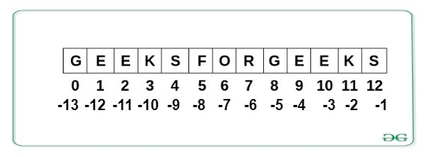

Slide 50
String1 = "Python is a language"
print("Initial String: ")
print(String1)
# Printing First character
print("\nFirst character of String is: ")
print(String1[0])
# Printing Last character
print("\nLast character of String is: ")
print(String1[-1])

Slide 51
Output:
Initial String:
Python is a language
First character of String is:
P
Last character of String is:
e

Slide 52
List
Lists are just like the arrays, declared in other languages which is a ordered collection of data. It is very flexible as the items in a list do not need to be of the same type.

Slide 53
Creating List
Lists in Python can be created by just placing the sequence inside the square brackets[].

Slide 54
List = []
print("Intial blank List: ")
print(List)
# Creating a List with
# the use of a String
List = ['Python is popular']
print("\nList with the use of String: ")
print(List)

Slide 55
# Creating a List with
# the use of multiple values
List = ["Python", "For", "Python"]
print("\nList containing multiple values: ")
print(List[0])
print(List[2])
# Creating a Multi-Dimensional List
# (By Nesting a list inside a List)
List = [['Python', 'For'], ['Programming']]
print("\nMulti-Dimensional List: ")
print(List)

Slide 56
Output:
Intial blank List:
[]
List with the use of String:
['Pythonispopular']
List containing multiple values:
Python
Python
Multi-Dimensional List:
[['Python', 'For'], ['Programming']]

Slide 57
Accessing elements of List
In order to access the list items refer to the index number. Use the index operator [ ] to access an item in a list. In Python, negative sequence indexes represent positions from the end of the array. Instead of having to compute the offset as in List[len(List)-3], it is enough to just write List[-3]. Negative indexing means beginning from the end, -1 refers to the last item, -2 refers to the second-last item, etc.

Slide 58
# Python program to demonstrate
# accessing of element from list
# Creating a List with
# the use of multiple values
List = ["Python", "For", "Programmers"]
# accessing a element from the
# list using index number
print("Accessing element from the list")
print(List[0])
print(List[2])

Slide 59
# accessing a element using
# negative indexing
print("Accessing element using negative indexing")
# print the last element of list
print(List[-1])
# print the third last element of list
print(List[-3])

Slide 60
Example :
a = [5,10,15,20,25,30,35,40]
# a[2] = 15
print("a[2] = ", a[2])
# a[0:3] = [5, 10, 15]
print("a[0:3] = ", a[0:3])
# a[5:] = [30, 35, 40]
print("a[5:] = ", a[5:])

Slide 61
Output
a[2] = 15
a[0:3] = [5, 10, 15]
a[5:] = [30, 35, 40]

Slide 62
Lists are mutable, meaning, the value of elements of a list can be altered.
a = [1, 2, 3]
a[2] = 4
print(a)
Output:
[1, 2, 4]

Slide 63
TUPLE
Just like list, tuple is also an ordered collection of Python objects. The only difference between type and list is that tuples are immutable i.e. tuples cannot be modified after it is created. It is represented by tuple class.

Slide 64
Creating Tuple
In Python, tuples are created by placing a sequence of values separated by ‘comma’ with or without the use of parentheses for grouping of the data sequence. Tuples can contain any number of elements and of any datatype (like strings, integers, list, etc.).

Slide 65
Note: Tuples can also be created with a single element, but it is a bit tricky. Having one element in the parentheses is not sufficient, there must be a trailing ‘comma’ to make it a tuple.

Slide 66
# Python program to demonstrate
# creation of Set
# Creating an empty tuple
Tuple1 = ()
print("Initial empty Tuple: ")
print (Tuple1)
# Creating a Tuple with
# the use of Strings
Tuple1 = ('King', 'For')
print("\nTuple with the use of String: ")
print(Tuple1)

Slide 67
# Creating a Tuple with
# the use of list
list1 = [1, 2, 4, 5, 6]
print("\nTuple using List: ")
print(tuple(list1))
# Creating a Tuple with the
# use of built-in function
Tuple1 = tuple('King')
print("\nTuple with the use of function: ")
print(Tuple1)

Slide 68
# Creating a Tuple
# with nested tuples
Tuple1 = (0, 1, 2, 3)
Tuple2 = ('python', 'king')
Tuple3 = (Tuple1, Tuple2)
print("\nTuple with nested tuples: ")
print(Tuple3)

Slide 69
Output:
Initial empty Tuple:
()
Tuple with the use of String:
('King', 'For')
Tuple using List:
(1, 2, 4, 5, 6)
Tuple with the use of function:
('K', 'i', 'n', 'g')
Tuple with nested tuples:
((0, 1, 2, 3), ('python', 'king'))

Slide 70
Accessing elements of Tuple
In order to access the tuple items refer to the index number. Use the index operator [ ] to access an item in a tuple. The index must be an integer. Nested tuples are accessed using nested indexing.

Slide 71
# Python program to
# demonstrate accessing tuple
tuple1 = tuple([1, 2, 3, 4, 5])
# Accessing element using indexing
print("Frist element of tuple")
print(tuple1[0])
# Accessing element from last
# negative indexing
print("\nLast element of tuple")
print(tuple1[-1])
print("\nThird last element of tuple")
print(tuple1[-3])

Slide 72
Example :
t = (5,'program', 1+3j)
# t[1] = 'program'
print("t[1] = ", t[1])
# t[0:3] = (5, 'program', (1+3j))
print("t[0:3] = ", t[0:3])
# Generates error
# Tuples are immutable
t[0] = 10

Slide 73
Output
t[1] = program
t[0:3] = (5, 'program', (1+3j))
Traceback (most recent call last):
File "test.py", line 11, in <module>
t[0] = 10
TypeError: 'tuple' object does not support item assignment

Slide 74
Boolean
Data type with one of the two built-in values, True or False. Boolean objects that are equal to True are truthy (true), and those equal to False are falsy (false). But non-Boolean objects can be evaluated in Boolean context as well and determined to be true or false. It is denoted by the class bool.

Slide 75
Set
In Python, Set is an unordered collection of data type that is iterable, mutable and has no duplicate elements. The order of elements in a set is undefined though it may consist of various elements.

Slide 76
Creating Sets
Sets can be created by using the built-in set() function with an iterable object or a sequence by placing the sequence inside curly braces, separated by ‘comma’. Type of elements in a set need not be the same, various mixed-up data type values can also be passed to the set.

Slide 77
# Python program to demonstrate
# Creation of Set in Python
# Creating a Set
set1 = set()
print("Intial blank Set: ")
print(set1)
# Creating a Set with
# the use of a String
set1 = set("PythonForKing")
print("\nSet with the use of String: ")
print(set1)

Slide 78
# Creating a Set with
# the use of a List
set1 = set(["Python", "For", "King"])
print("\nSet with the use of List: ")
print(set1)
# Creating a Set with
# a mixed type of values
# (Having numbers and strings)
set1 = set([1, 2, 'Python', 4, 'For', 6, 'King'])
print("\nSet with the use of Mixed Values")
print(set1)

Slide 79
Accessing elements of Sets
Set items cannot be accessed by referring to an index, since sets are unordered the items has no index. But you can loop through the set items using a for loop, or ask if a specified value is present in a set, by using the in keyword.

Slide 80
# Python program to demonstrate
# Accessing of elements in a set
# Creating a set
set1 = set(["Goal", "For", "Life"])
print("\nInitial set")
print(set1)

Slide 81
# Accessing element using
# for loop
print("\nElements of set: ")
for i in set1:
print(i, end =" ")
# Checking the element
# using in keyword
print("Goal" in set1)

Slide 82
Example :
a = {5,2,3,1,4}
# printing set variable
print("a = ", a)
# data type of variable a
print(type(a))

Slide 83
Output
a = {1, 2, 3, 4, 5}
<class 'set'>

Slide 84
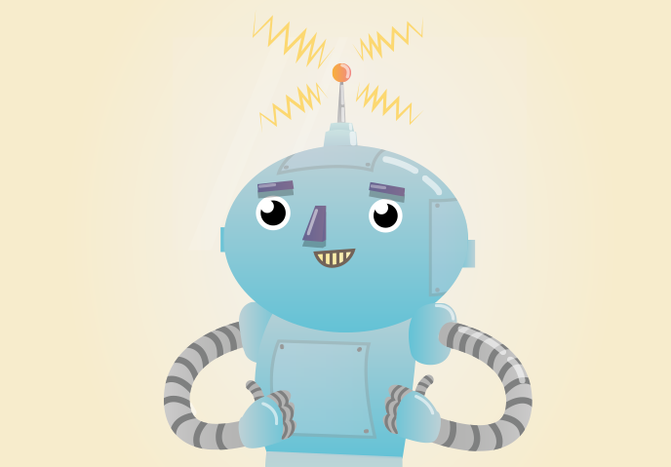
Branching Programs : Branching is an all important concept to learn when programming in Python. If, Else and Elif statements enable your program to be smart and make decisions.

Slide 85
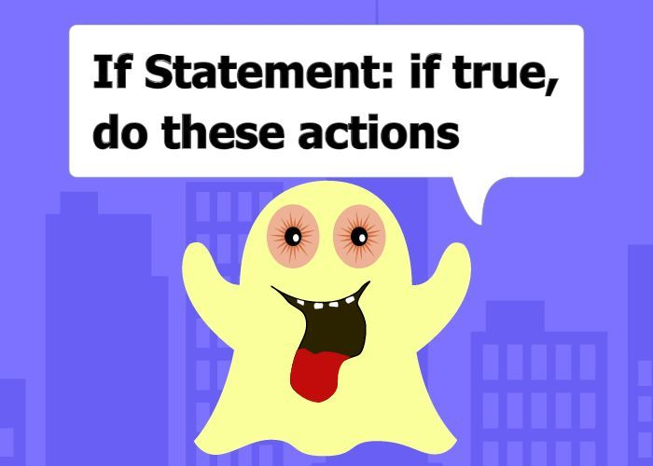
if statement
if statement is the most simple decision making statement. It is used to decide whether a certain statement or block of statements will be executed or not i.e if a certain condition is true then a block of statement is executed otherwise not.

Slide 86
Example :
password = "qwerty"
attempt = input("Enter password: ")
if attempt == password:
print("Welcome")

Slide 87
As we know, python uses indentation to identify a block. So the block under an if statement will be identified as shown in the below example:
if condition:
statement1
statement2
# Here if the condition is true, if block
# will consider only statement1 to be inside
# its block.

Slide 88
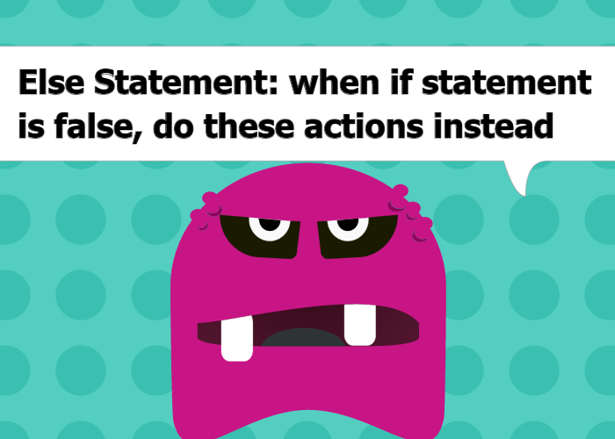
if- else
The if statement alone tells us that if a condition is true it will execute a block of statements and if the condition is false it won’t. But what if we want to do something else if the condition is false. Here comes the else statement. We can use the else statement with if statement to execute a block of code when the condition is false.

Slide 89
Syntax:
if (condition):
# Executes this block if
# condition is true
else:
# Executes this block if
# condition is false

Slide 90
# python program to illustrate If else statement
i = 20;
if (i < 15):
print ("i is smaller than 15")
print ("i'm in if Block")
else:
print ("i is greater than 15")
print ("i'm in else Block")
print ("i'm not in if and not in else Block")

Slide 91
Output:
i is greater than 15
i'm in else Block
i'm not in if and not in else Block

Slide 92
Example :
if attempt == password:
print("Welcome")
else:
print("Incorrect password!")

Slide 93
if-elif-else ladder
Here, a user can decide among multiple options. The if statements are executed from the top down. As soon as one of the conditions controlling the if is true, the statement associated with that if is executed, and the rest of the ladder is bypassed. If none of the conditions is true, then the final else statement will be executed.

Slide 94
Syntax:-
if (condition):
statement
elif (condition):
statement
.
.
else:
statement

Slide 95
# Python program to illustrate if-elif-else ladder
i = 20
if (i == 10):
print ("i is 10")
elif (i == 15):
print ("i is 15")
elif (i == 20):
print ("i is 20")
else:
print ("i is not present")

Slide 96
Short Hand If
If you have only one statement to execute, you can put it on the same line as the if statement.
Example
One line if statement:
if a > b: print("a is greater than b")

Slide 97
Short Hand If ... Else
If you have only one statement to execute, one for if, and one for else, you can put it all on the same line:
Example
One line if else statement:
a = 2
b = 330
print("A") if a > b else print("B")

Slide 98
Input & String :
Python provides us with two inbuilt functions to read the input from the keyboard.
input ( prompt )
input ( ) : This function first takes the input from the user and then evaluates the expression, which means Python automatically identifies whether user entered a string or a number or list. If the input provided is not correct then either syntax error or exception is raised by python. For example –

Slide 99
# Python program showing
# a use of input()
val = input("Enter your value: ")
print(val)

Slide 100
# Program to check input
# type in Python
num = input ("Enter number :")
print(num)
name1 = input("Enter name : ")
print(name1)
# Printing type of input value
print ("type of number", type(num))
print ("type of name", type(name1))

Slide 101
Example :
inputString = input()
print('The inputted string is:', inputString)
# get input from user
inputString = input('Enter a string:')
print('The inputted string is:', inputString)

Slide 102
ifElseExample2.py
print("Please enter your age: \n")
# Declare a variable to store the user input from the keyboard.
inputStr = input()
# int(..) function convert string to integer
age = int(inputStr)
# Print out your age
print("Your age: ", age)

Slide 103
# If age < 80 then ..
if (age < 80) :
print("You are pretty young")
# Else if age between 80, 100 then
elif (age >= 80 and age <= 100) :
print("You are old")
# Else (Other case)
else :
print("You are verry old")

Slide 104
Strings
Assign String to a Variable
Assigning a string to a variable is done with the variable name followed by an equal sign and the string:
Example
a = "Hello"
print(a)

Slide 105
Multiline Strings
You can assign a multiline string to a variable by using three quotes:
Example
You can use three double quotes:
a = """Please, no matter how we advance technologically, please don't abandon the book. There is nothing in our material world more beautiful than the book."""
print(a)

Slide 106
Strings are Arrays
Like many other popular programming languages, strings in Python are arrays of bytes representing unicode characters.
However, Python does not have a character data type, a single character is simply a string with a length of 1.

Slide 107
Square brackets can be used to access elements of the string.
Example
Get the character at position 1 (remember that the first character has the position 0):
a = "Hello, World!"
print(a[1])

Slide 108
String Length
To get the length of a string, use the len() function.
Example
The len() function returns the length of a string:
a = "Hello, World!"
print(len(a))

Slide 109
Check String
To check if a certain phrase or character is present in a string, we can use the keyword in.
Example
Check if "free" is present in the following text:
txt = "The best things in life are free!"
print("free" in txt)

Slide 110
Use it in an if statement:
Example
Print only if "free" is present:
txt = "The best things in life are free!"
if "free" in txt:
print("Yes, 'free' is present.")

Slide 111
Check if NOT
To check if a certain phrase or character is NOT present in a string, we can use the keyword not in.
Example
Check if "expensive" is NOT present in the following text:
txt = "The best things in life are free!"
print("expensive" not in txt)

Slide 112
Iteration
Repeating identical or similar tasks without making errors is something that computers do well and people do poorly.
Repeated execution of a set of statements is called iteration.

Slide 113
Python doesn’t have traditional for loops. Let’s see a pseudocode of how a traditional for loop looks in many other programming languages.
for (initializer; condition; iterator)
body

Slide 114
A for loop is used for iterating over a sequence (that is either a list, a tuple, a dictionary, a set, or a string).
This is less like the for keyword in other programming languages, and works more like an iterator method as found in other object-orientated programming languages.
With the for loop we can execute a set of statements, once for each item in a list, tuple, set etc.

Slide 115
Example
Print each fruit in a fruit list:
fruits = ["apple", "banana", "cherry"]
for x in fruits:
print(x)

Slide 116
Looping Through a String
Even strings are iterable objects, they contain a sequence of characters:
Example
Loop through the letters in the word "banana":
for x in "banana":
print(x)

Slide 117
The break Statement
With the break statement we can stop the loop before it has looped through all the items:
Example
Exit the loop when x is "banana":
fruits = ["apple", "banana", "cherry"]
for x in fruits:
print(x)
if x == "banana":
break

Slide 118
Example
Exit the loop when x is "banana", but this time the break comes before the print:
fruits = ["apple", "banana", "cherry"]
for x in fruits:
if x == "banana":
break
print(x)

Slide 119
The continue Statement
With the continue statement we can stop the current iteration of the loop, and continue with the next:
Example
Do not print banana:
fruits = ["apple", "banana", "cherry"]
for x in fruits:
if x == "banana":
continue
print(x)

Slide 120
The range() Function
To loop through a set of code a specified number of times, we can use the range() function,
The range() function returns a sequence of numbers, starting from 0 by default, and increments by 1 (by default), and ends at a specified number.

Slide 121
Example
Using the range() function:
for x in range(6):
print(x)
Note that range(6) is not the values of 0 to 6, but the values 0 to 5.

Slide 122
The range() function defaults to 0 as a starting value, however it is possible to specify the starting value by adding a parameter: range(2, 6), which means values from 2 to 6 (but not including 6):
Example
Using the start parameter:
for x in range(2, 6):
print(x)

Slide 123
The range() function defaults to increment the sequence by 1, however it is possible to specify the increment value by adding a third parameter: range(2, 30, 3):
Example
Increment the sequence with 3 (default is 1):
for x in range(2, 30, 3):
print(x)

Slide 124
Else in For Loop
The else keyword in a for loop specifies a block of code to be executed when the loop is finished:
Example
Print all numbers from 0 to 5, and print a message when the loop has ended:
for x in range(6):
print(x)
else:
print("Finally finished!")

Slide 125
Nested Loops
A nested loop is a loop inside a loop.
The "inner loop" will be executed one time for each iteration of the "outer loop":
Example
Print each adjective for every fruit:
adj = ["red", "big", "tasty"]
fruits = ["apple", "banana", "cherry"]
for x in adj:
for y in fruits:
print(x, y)

Slide 126
The pass Statement
for loops cannot be empty, but if you for some reason have a for loop with no content, put in the pass statement to avoid getting an error.
Example
for x in [0, 1, 2]:
pass

Slide 127
While Loops
With the while loop we can execute a set of statements as long as a condition is true.
Example
Print i as long as i is less than 6:
i = 1
while i < 6:
print(i)
i += 1

Slide 128
The else Statement
With the else statement we can run a block of code once when the condition no longer is true:
Example
Print a message once the condition is false:
i = 1
while i < 6:
print(i)
i += 1
else:
print("i is no longer less than 6")

Slide 129
Enumerate:
Enumerate is built-in python function that takes input as iterator, list etc and returns a tuple containing index and data at that index in the iterator sequence. For example, enumerate(cars), returns a iterator that will return (0, cars[0]), (1, cars[1]), (2, cars[2]), and so on.

Slide 130
# Accessing items using enumerate()
cars = ["Aston" , "Audi", "McLaren "]
for i, x in enumerate(cars):
print (x)

Slide 131
# Accessing items and indexes enumerate()
cars = ["Aston" , "Audi", "McLaren "]
for x in enumerate(cars):
print (x[0], x[1])

Slide 132
# Printing return value of enumerate()
cars = ["Aston" , "Audi", "McLaren "]
print enumerate(cars)
Output :
[(0, 'Aston'), (1, 'Audi'), (2, 'McLaren ')]

Slide 133
Python Iterators
An iterator is an object that contains a countable number of values.
An iterator is an object that can be iterated upon, meaning that you can traverse through all the values.
Technically, in Python, an iterator is an object which implements the iterator protocol, which consist of the methods __iter__() and __next__().

Slide 134
Iterator vs Iterable
Lists, tuples, dictionaries, and sets are all iterable objects. They are iterable containers which you can get an iterator from.
All these objects have a iter() method which is used to get an iterator:
Example
Return an iterator from a tuple, and print each value:
mytuple = ("apple", "banana", "cherry")
myit = iter(mytuple)
print(next(myit))
print(next(myit))
print(next(myit))

Slide 135
Example
Strings are also iterable objects, containing a sequence of characters:
mystr = "banana"
myit = iter(mystr)
print(next(myit))
print(next(myit))
print(next(myit))
print(next(myit))
print(next(myit))
print(next(myit))

Slide 136
FUNCTIONS :
A function is a block of code which only runs when it is called.
You can pass data, known as parameters, into a function.
A function can return data as a result.

Slide 137
In Python a function is defined using the def keyword:
Example
def my_function():
print("Hello from a function")

Slide 138
To call a function, use the function name followed by parenthesis:
Example
def my_function():
print("Hello from a function")
my_function()

Slide 139
Arguments
Information can be passed into functions as arguments.
Arguments are specified after the function name, inside the parentheses. You can add as many arguments as you want, just separate them with a comma.

Slide 140
The following example has a function with one argument (fname). When the function is called, we pass along a first name, which is used inside the function to print the full name:
Example
def my_function(fname):
print(fname + " Refsnes")
my_function("Emil")
my_function("Tobias")
my_function("Linus")

Slide 141
Example
This function expects 2 arguments, and gets 2 arguments:
def my_function(fname, lname):
print(fname + " " + lname)
my_function("Emil", "Refsnes")

Slide 142
Keyword Arguments
You can also send arguments with the key = value syntax.
This way the order of the arguments does not matter.
Example
def my_function(child3, child2, child1):
print("The youngest child is " + child3)
my_function(child1 = "Emil", child2 = "Tobias", child3 = "Linus")

Slide 143
The following example shows how to use a default parameter value.
If we call the function without argument, it uses the default value:
Example
def my_function(country = "Norway"):
print("I am from " + country)
my_function("Sweden")
my_function("India")
my_function()
my_function("Brazil")

Slide 144
Passing a List as an Argument
You can send any data types of argument to a function (string, number, list, dictionary etc.), and it will be treated as the same data type inside the function.
E.g. if you send a List as an argument, it will still be a List when it reaches the function:
Example
def my_function(food):
for x in food:
print(x)
fruits = ["apple", "banana", "cherry"]
my_function(fruits)

Slide 145
def apply(L, f):
"""
Applies function given by f to each element in L
Parameters
----------
L : list containing the operands
f : the function
Returns
-------
result: resulting list
"""
result = []
for i in range(len(L)):
result.append(f(L[i]))
return result

Slide 146
Let’s see how we can call this function:
L = [1, -2, -5, 6.2]
print (apply(L, abs)) # [1, 2, 5, 6.2]
# abs is applied on elements passed in L
print (apply(L, int)) # [1, -2, -5, 6]

Slide 147
Python - Dictionary :
Each key is separated from its value by a colon (:), the items are separated by commas, and the whole thing is enclosed in curly braces. An empty dictionary without any items is written with just two curly braces, like this: {}.
Keys are unique within a dictionary while values may not be. The values of a dictionary can be of any type, but the keys must be of an immutable data type such as strings, numbers, or tuples.

Slide 148
Creating Python Dictionary
Creating a dictionary is as simple as placing items inside curly braces {} separated by commas.
An item has a key and a corresponding value that is expressed as a pair (key: value).
While the values can be of any data type and can repeat, keys must be of immutable type (string, number or tuple with immutable elements) and must be unique.

Slide 149
# empty dictionary
my_dict = {}
# dictionary with integer keys
my_dict = {1: 'apple', 2: 'ball'}
# dictionary with mixed keys
my_dict = {'name': 'John', 1: [2, 4, 3]}

Slide 150
# using dict()
my_dict = dict({1:'apple', 2:'ball'})
# from sequence having each item as a pair
my_dict = dict([(1,'apple'), (2,'ball')])
we can also create a dictionary using the built-in dict() function.

Slide 151
Accessing Elements from Dictionary
While indexing is used with other data types to access values, a dictionary uses keys. Keys can be used either inside square brackets [] or with the get() method.
If we use the square brackets [], KeyError is raised in case a key is not found in the dictionary. On the other hand, the get() method returns None if the key is not found.

Slide 152
# get vs [] for retrieving elements
my_dict = {'name': 'Jack', 'age': 26}
# Output: Jack
print(my_dict['name'])
# Output: 26
print(my_dict.get('age'))

Slide 153
# Trying to access keys which doesn't exist throws error
# Output None
print(my_dict.get('address'))
# KeyError
print(my_dict['address'])

Slide 154
Output
Jack
26
None
Traceback (most recent call last):
File "<string>", line 15, in <module>
print(my_dict['address'])
KeyError: 'address'

Slide 155
Changing and Adding Dictionary elements
Dictionaries are mutable. We can add new items or change the value of existing items using an assignment operator.
If the key is already present, then the existing value gets updated. In case the key is not present, a new (key: value) pair is added to the dictionary.

Slide 156
# Changing and adding Dictionary Elements
my_dict = {'name': 'Jack', 'age': 26}
# update value
my_dict['age'] = 27
#Output: {'age': 27, 'name': 'Jack'}
print(my_dict)

Slide 157
# add item
my_dict['address'] = 'Downtown'
# Output: {'address': 'Downtown', 'age': 27, 'name': 'Jack'}
print(my_dict)
Output
{'name': 'Jack', 'age': 27}
{'name': 'Jack', 'age': 27, 'address': 'Downtown'}

Slide 158
Delete Dictionary Elements
You can either remove individual dictionary elements or clear the entire contents of a dictionary. You can also delete entire dictionary in a single operation.
To explicitly remove an entire dictionary, just use the del statement. Following is a simple example

Slide 159
dict = {'Name': 'Zara', 'Age': 7, 'Class': 'First'}
del dict['Name']; # remove entry with key 'Name'
dict.clear(); # remove all entries in dict
del dict ; # delete entire dictionary
print "dict['Age']: ", dict['Age']
print "dict['School']: ", dict['School']

Slide 160
This produces the following result. Note that an exception is raised because after del dict dictionary does not exist any more −
dict['Age']:
Traceback (most recent call last):
File "test.py", line 8, in <module>
print "dict['Age']: ", dict['Age'];
TypeError: 'type' object is unsubscriptable

Slide 161
Store Function as dictionary value :
Given a dictionary, assign its keys as function calls.
Case 1 : Without Params.
The way that is employed to achieve this task is that, function name is kept as dictionary values, and while calling with keys, brackets ‘()’ are added.

Slide 162
# Using Without params
# call Gfg fnc
def print_key1():
return "This is Gfg's value"
# initializing dictionary
# check for function name as key
test_dict = {"Gfg": print_key1, "is" : 5, "best" : 9}

Slide 163
# printing original dictionary
print("The original dictionary is : " + str(test_dict))
# calling function using brackets
res = test_dict['Gfg']()
# printing result
print("The required call result : " + str(res))

Slide 164
Output
The original dictionary is : {'Gfg': <function print_key1 at 0x7f1c0445be18>, 'is': 5, 'best': 9}
The required call result : This is Gfg's value

Slide 165
Case 2 : With params
# Using With params
# call Gfg fnc
def sum_key(a, b):
return a + b
# initializing dictionary
# check for function name as key
test_dict = {"Gfg": sum_key, "is" : 5, "best" : 9}

Slide 166
# printing original dictionary
print("The original dictionary is : " + str(test_dict))
# calling function using brackets
# params inside brackets
res = test_dict['Gfg'](10, 34)
# printing result
print("The required call result : " + str(res))

Slide 167
Output
The original dictionary is : {'Gfg': <function sum_key at 0x7f538d017e18>, 'is': 5, 'best': 9}
The required call result : 44

Slide 168
UNIT 1 COMPLETED

